Slide 1
SOLID principles
Karn Pratap Singh

Slide 2
What are SOLID Design Principles?
SOLID is a popular set of design principles that are used in object-oriented software development.
SOLID is an acronym which stands for:
S : Single Responsibility Principle
O : Open- Closed Principle
L : Liskov Substitution Principle
I : Interface Segregation Principle
D : Dependency Inversion Principle

Slide 3
Why use SOLID principles?
Reduces dependencies so that engineers change one area of software without impacting others.
Makes the code easier to understand.
Makes the software easier to test and maintain.

Slide 4
Single Responsibility Principle
This principle says that each class only does one thing and every class or module only has responsibility for one part of the software’s functionality.
Advantage of it is that we have fewer test cases for each class.

Slide 5
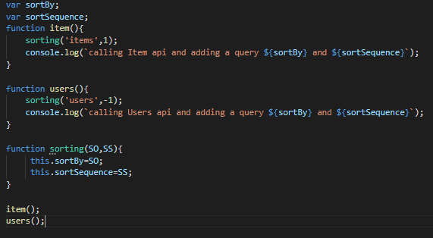
Example of Single Responsibility:
In the above example each function has only function to perform. The ‘item()’ function only
calls item api, ‘users()’ function calls users api and ‘sorting()’ function only gives the instruction
about how to sort the list in users or items.

Slide 6
Open-closed principle
This principle says that we should be able to extend a class’s behavior without modifying it.
Modifying the code can create new bugs. To prevent ourselves from it, we must follow this principle.

Slide 7
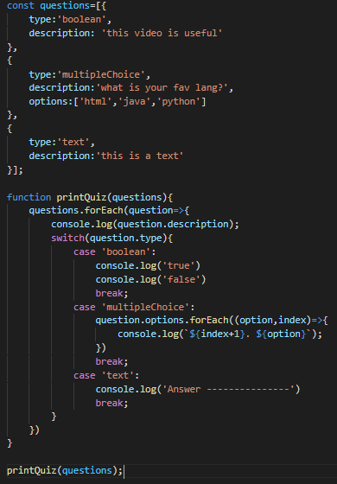
Example of Open-closed principle:
This code does not follow open-closed principle.
As adding anything new in the questions array,
we will have to modify the printQuiz() function.

Slide 8
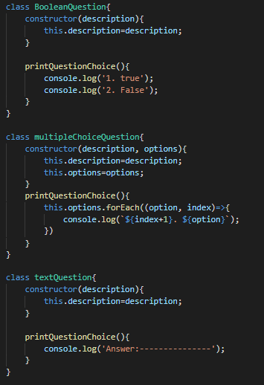
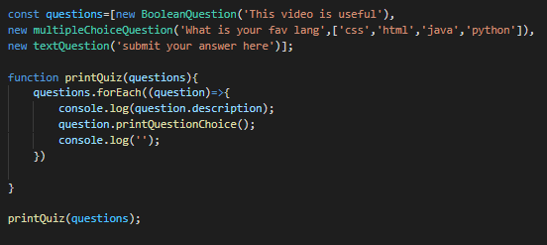
The code below does the same operation as the previous one.
But this one follows Open closed principle. We can easily add new classes as new functionality without disturbing the printQuiz() function.
Part 1.
Part 2.

Slide 9
Liskov Substitution principle
This principle simply requires that every derived class should be substitutable for its parent class.
Code that adheres to LSP is loosely dependent to each other and encourages code reusability.

Slide 10
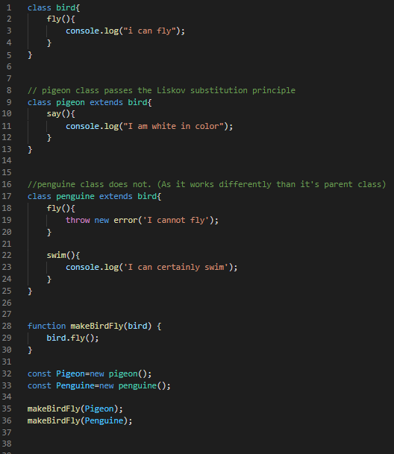
Example of Liskov Substitution:
In this code example we can see that penguin class cannot substitute the bird class properly. Hence this code does not follow the Liskov Substitution principle.

Slide 11
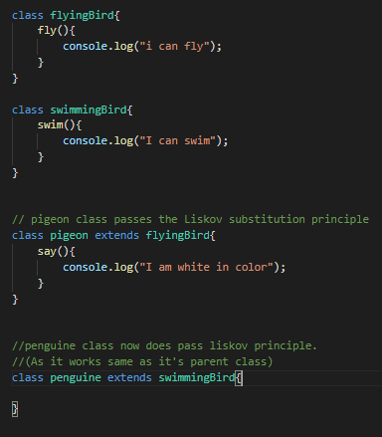
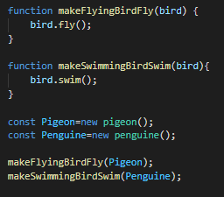
The code below now follows the Liskov Substitution as each derived class can substitute it’s parent class.
Part 1.
Part 2.

Slide 12
Interface Segregation Principle
The interface-segregation principle (ISP) states that no client should be forced to depend on methods it does not use.
Advantage: We are reducing our class implementation only to required actions without any additional or unnecessary code.

Slide 13
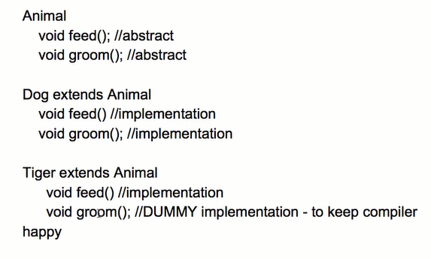
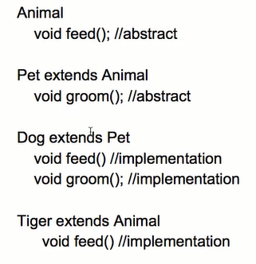
Example of Interface segregation:
In the first code we see that out tiger class has no need of groom() function, yet we have to include it in that class, just so that our code compiles successfully. But in the second class we eliminate this dependency over unnecessary functions by creating a new class.

Slide 14
Dependency Inversion Principle
The Dependency Inversion Principle (DIP) states that high level modules should not depend on low level modules. Secondly, abstractions should not depend upon details; details should depend upon abstractions.
It gives flexibility and stability at the level of the entire architecture of your application. It will allow your application to evolve more securely and stable.
Notes:
Secondly, abstractions should not depend upon details; details should depend upon abstractions.

